Slide 1
Reimagining housing for all

Slide 2
“Is not this the fast that I choose: to loose the bonds of injustice, to undo the straps of the yoke, to let the oppressed go free, and to break every yoke? Is it not to share your bread with the hungry and bring the homeless poor into your house; when you see the naked, to cover them and not to hide yourself from your own kin?” (Isaiah 58:6-7, NRSV)
“Everyone has the right to a standard of living adequate for the health and well-being of himself and of his family, including food, clothing, housing and medical care and necessary social services …” Article 25(1), Universal Declaration of Human Rights.

Slide 3
Federal housing policy

Slide 4
Housing needs and trends in Dane County

Slide 5
Resources
Dane County Housing Initiative: https://danehousing.countyofdane.com/
City of Madison housing reports: https://www.cityofmadison.com/dpced/community-development/reports
Dane County housing needs assessment (2019): https://danehousing.countyofdane.com/documents/assessmentReport/2019/Dane-County-Housing-Needs-Assessment-2019.pdf
Dane County Community Plan to End Homelessness: https://www.danecountyhomeless.org/_files/ugd/73dee7_453baa4a2fc4463e87ead88fc0bff74b.pdf
Dane County Homeless Services Consortium: https://www.danecountyhomeless.org/
National Low-Income Housing Coalition’s Advocates Guide: https://nlihc.org/explore-issues/publications-research/advocates-guide

Slide 6
Housing Demand: demographics and income/jobs
Key messages:
- continued strong demand for housing, job growth
- previous analysis: Jobs annualized growth rate 1.7%/year, expect resume
- households growing faster than population; decreasing household size
- rent growth (adj. inflation) down from previous period
- renter income growth exceeds owners; displaced demand for ownership

Slide 7
Rent
According to the Zumper National Rent Report (February 2023) for Madison area:
Median 1-bedroom rent is $1,340 per month (Y/Y% change is +24%).
Median 2-bedroom rent is $1,600 per month (Y/Y% change is +9.6%).
According to Apartment List National Rent Report (February 2023) for Madison area:
Median 1-bedroom rent is $1,403 per month.
Median 2-bedroom rent is $1,662 per month.
Year over year change for all rents are +14.8%.

Slide 10
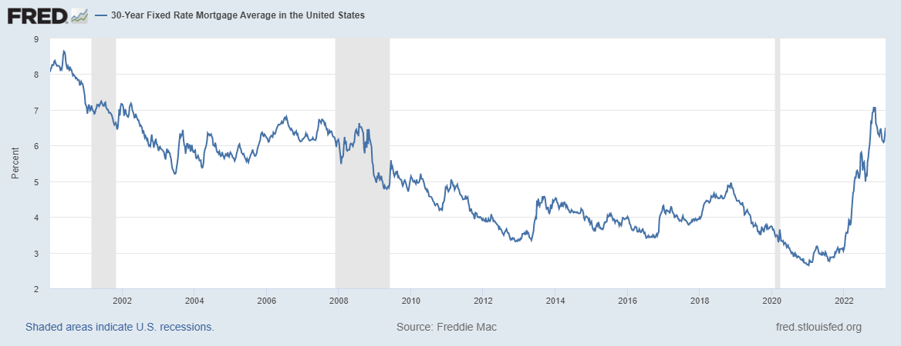
Mortgage Interest Rates Rising

Slide 12
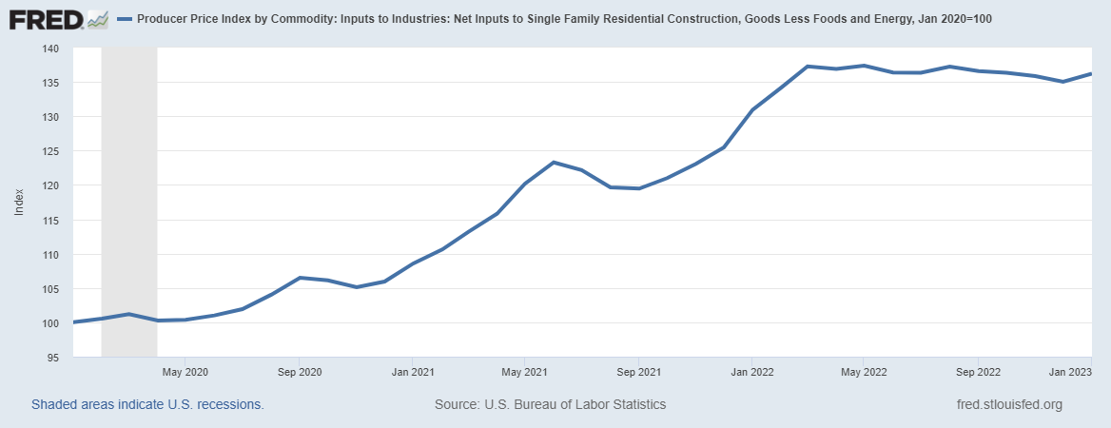
Single-family Construction Costs up 36.2 percent
(Jan. 2020 to Jan. 2023)

Slide 13
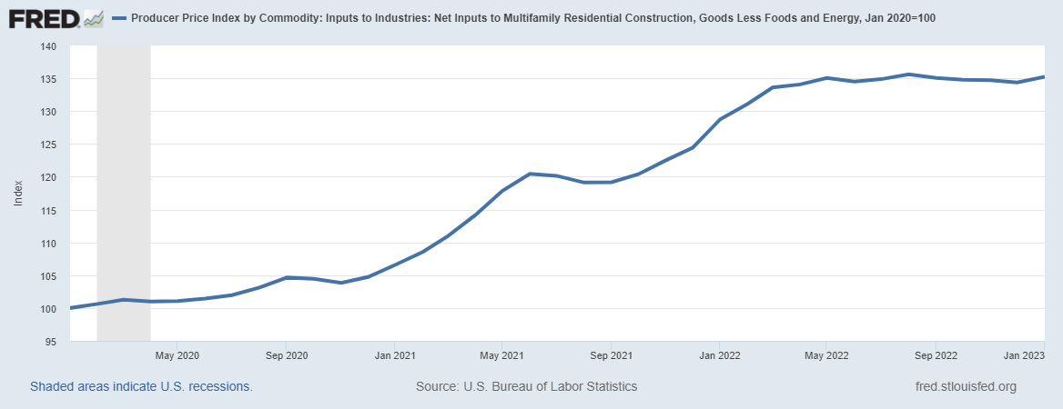
Multifamily Construction Costs Up 35.2 percent
(Jan. 2020-Jan. 2023)

Slide 15
Lack of affordable housing in Dane County
For renting households with incomes less than 30 percent Area Median Income (AMI), most recent data (through 2019):
17,010 households pay more than 30 percent of income on rent (“cost-burdened”) and of that, 13,035 pay more than 50 percent of income on rent (“extremely cost-burdened).
For renting households with incomes between 30 and 50 percent AMI,
12,410 households pay more than 30 percent of income on rent (“cost-burdened”) and of that, 1,475 pay more than 50 percent of income on rent (“extremely cost-burdened).
Summary: 14,510 very-low-income families (less than 50 percent AMI) pay MORE THAN 50 PERCENT OF THEIR INCOME TO RENT

Slide 16
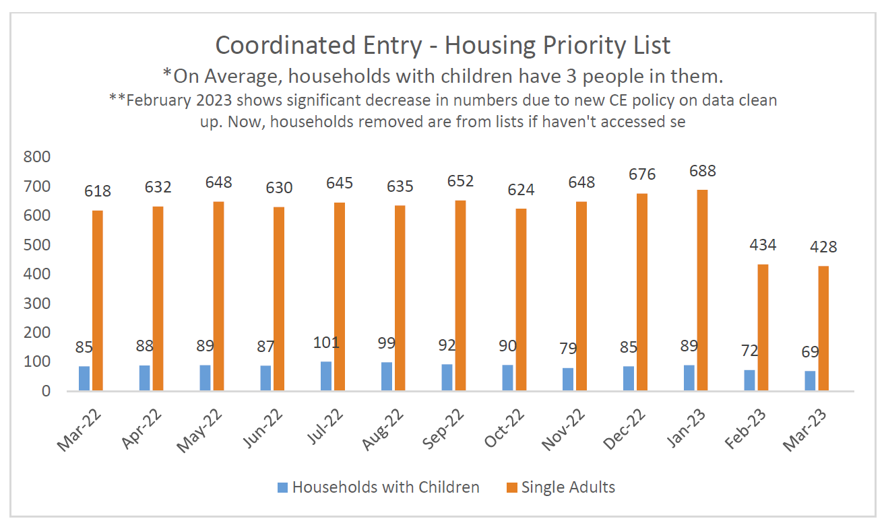

Slide 17
Students experiencing homeless (Dane County Public Schools)
1,865 students
Definition of homeless for schools is lacking a fixed, regular, and adequate nighttime residence
Latest data available through DPI is 2018-19 school year
MMSD (1,244), Sun Prairie (127), Verona (121), Middleton Cross Plains (115).

Slide 18
Next steps categories

